Slide 1

UNIVERSITY college for women (autonomous ) Koti, Hyderabad
BY
GATLA SRIJA
MCA III YEAR VI-SEM
Roll.No:1013-19-862-021
UNDER SUPERVISION OF: Mrs. M.SUNEETHA &Mrs. T.S.SAVITA

Slide 2
Fraud detection using local outlier factor and isolation forest

Slide 3
INTRODUCTION
Identity theft:
Identity thieves usually obtain personal information such as passwords, ID numbers, credit card numbers or social security numbers, and misuse them to act fraudulently in the victim’s name.
These sensitive details can be used for various illegal purposes including applying for loans, making online purchases, or accessing victim’s medical and financial data.
Bank fraud detection sits at the top of the priorities list, considering online and offline transaction scams are the most widespread kind of financial fraud

Slide 4

financial IDENTITY THEFT
Financial identity theft is when one person uses another’s personal data for financial benefit. This is the most common form of identity theft.
Thieves rob your accounts
They rack up outrageous charges on credit cards ,and take out new loans and more
They destroy your credits, forcing you to pay higher rates
You can absolutely held responsible for the debts incurred by the thieves in your name

Slide 5
Online shopping - One of the largest and fast growing trend
Mode of Payment – Credit card, Debit card, Net Banking
Online Payments does not require physical cards
Major Risk – Credit/Debit card details known to others
Credit Card Fraud is one of the biggest threats to business establishments today. Credit card fraud begins either with the theft of the physical card or with the important data associated with the account, such as card account number or other information that necessarily be available to a merchant during a permissible transaction .
In order to reduce the losses which occur due to these credit card frauds, we need to build efficient fraud detecting systems

Slide 6
Literature survey/related work:
Kuldeep Randhawa et al [2010]:Machine learning to detect credit card fraud detection.
[10] Kuldeep Randhawa, Chu Kiong Loo, Manjeevan Seera, Chee Peng Lim and Asoke K. Nandi, "Credit card fraud detection using AdaBoost and majority voting," IEEE Access, vol. 6, pp. 14277-14284, 2018.
Abhimanyu Roy et al. [2011]:Deep learning topologies for the detection of fraud in online money transaction
[11] A. Roy and J. Sun and R. Mahoney and L. Alonzi and S. Adams and P. Beling, "Deep learning detecting fraud in credit card transactions," in Systems and Information Engineering Design Symposium (SIEDS), pp. 129-134, 2018.
Dilip Singh Sisodia et al. [2018]:The principal component analysis (PCA) is applied to real data to propose a novel approach.
[18] D. S. Sisodia, N. K. Reddy and S. Bhandari, "Performance evaluation of class balancing techniques for credit card fraud detection," IEEE International Conference on Power, Control, Signals and Instrumentation Engineering (ICPCSI), Chennai, pp. 2747-2752, 2017.

Slide 7
Outline the solution:
Dataset:
The dataset contains transactions made by credit cards in September 2013 by European cardholders.
we have analyze the dataset which is taken from Kaggle. The dataset is in CSV format (creditcard.csv)
It contains Credit card transactions which are made by customers during September 2013 in Europe containing 284,807 transactions.
By monitoring the behavior of the transactions Credit card transactions are characterized into two categories fraudulent and non-fraudulent.
Only numerical input variables are provided which are the results of Principal Component Analysis (PCA) Transformation. Features V1, V2 ... V28 are the principal components obtained with PCA, the only features which have not been transformed with PCA are 'Time' and 'Amount'.
Feature 'Class' is the response variable and it takes value 1 in case of fraud and 0 otherwise

Slide 8

Algorithms:
LOCAL OUTLIER FACTOR(LOF):
Local outlier factor (LOF) is an algorithm that identifies the outliers present in the dataset. But what does the local outlier mean?
When a point is considered as an outlier based on its local neighbourhood, it is a local outlier.
LOF will identify an outlier considering the density of the neighbourhood.

Slide 9
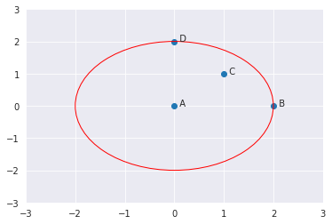


K-distance and K-neighbours:
K-distance is the distance between the point, and it’s Kᵗʰ nearest neighbour. K-neighbours denoted by Nₖ(A) includes a set of points that lie in or on the circle of radius K-distance.
Reachability distance (RD):
Local reachability density (LRD):
Local Outlier Factor (LOF):

Slide 10
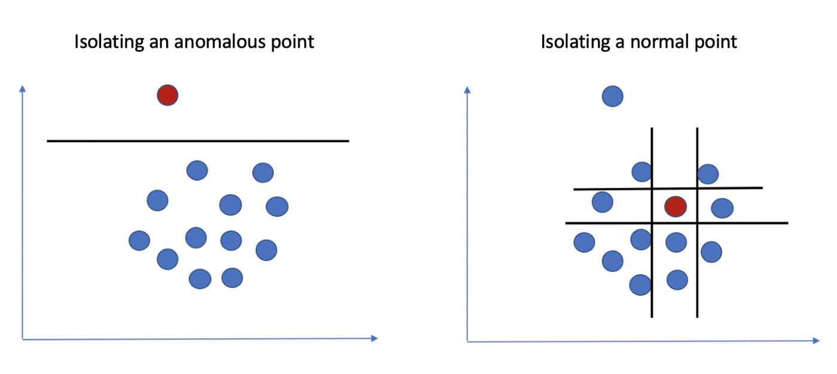
ISOLATION FOREST
Isolation forest is a tree-base model that is developed to detect outliers . This algorithm is based upon the fact that anomalies are the data points which are few and different.
These properties result in susceptible mechanism to anomalies which is known as Isolation.
To detect the anomalies rather than the basic distance and density measures it introduces the use of isolation as an efficient and more effectively.
This algorithm has small memory requirement and low linear time complexity. It builds a good performing model with a small number of trees using small sub-samples of fixed size, regardless of the size of a data set

Slide 11
Modules:
Importing the libraries
Read the dataset
Checking the missing values
Determine the number of fraud and valid transaction in dataset
Assigning the transaction class "0 = NORMAL & 1 = FRAUD"
Graphical representation of the data.
Create a Trace.
Correlation matrix.
Outlier Detection Methods.
Fit the model.

Slide 12
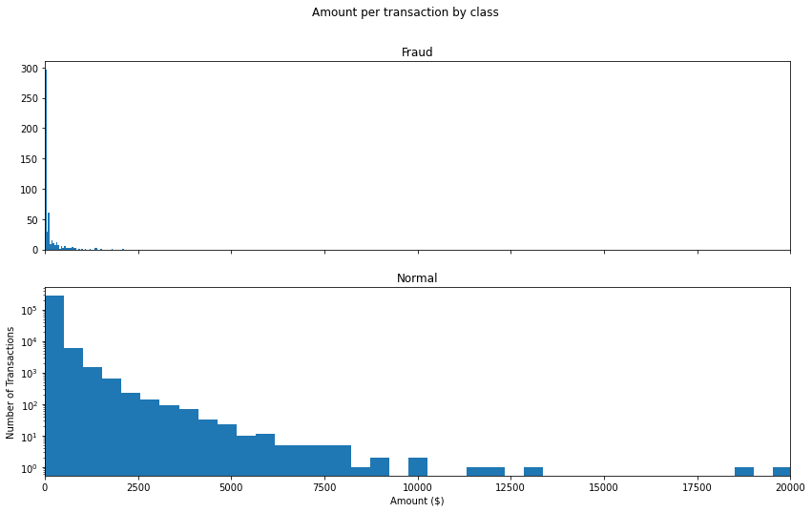
RESULTS AND DISCUSSION:
Many classification tasks use simple evaluation metrics such as Accuracy to compare performance between models, because accuracy is simple measure to implement and generalizes to more than just binary labels.
To classify the transactions as fraud or non-fraud we need some other standards of correctness which are as:
Precision
Recall
F1-score
Support

Slide 13
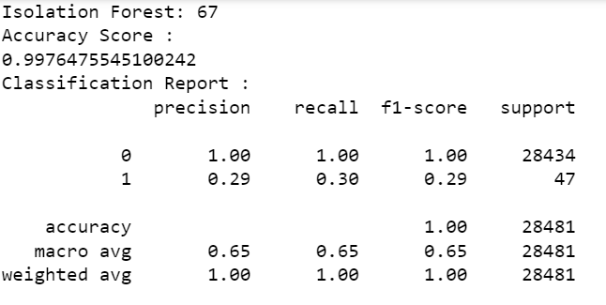
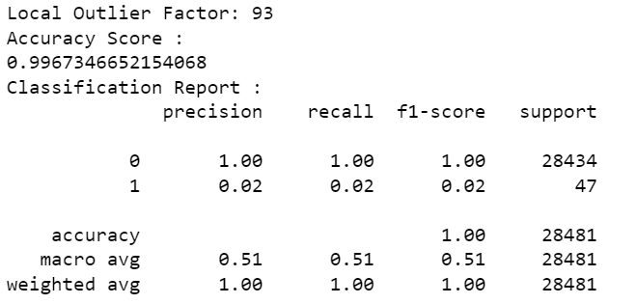

Slide 14
CONCLUSION AND FUTURE WORK
Isolation Forest detected 69 errors versus Local Outlier Factor detecting 93 errors
Isolation Forest has a 99.75% more accurate than LOF of 99.67%
When comparing error precision & recall for 2 models , the Isolation Forest performed much better than the LOF as we can see that the detection of fraud cases is around 27 % versus LOF detection
So overall Isolation Forest Method performed much better in determining the fraud cases which is around 30%.
We can also improve on this accuracy by increasing the sample size or use deep learning algorithms however at the cost of computational expense. We can also use complex anomaly detection models to get better accuracy in determining more fraudulent case

Slide 15
We have also made the comparison of the algorithms with some other algorithms and the values are given in below table:
ALGORITHM | ACCURACY
Isolation Forest | 99.76
Local Outlier Factor | 99.67

Slide 16
REFERENCE
https://www.kaggle.com/code/naveengowda16/anomaly-detection-credit-card-fraud-analysis
https://towardsdatascience.com/local-outlier-factor-lof-algorithm-for-outlier-identification-8efb887d9843
https://www.researchgate.net/publication/335809102_Credit_Card_Fraud_Detection_using_Local_Outlier_Factor_and_Isolation_Forest

Slide 17
THANK YOU

